Slide 1
CircuitGuard - PCB Defect Detection and Classification Application
NAME : Suswagata Ghosh
Internship provider: Infosys Springboard

Slide 2
Methodology:
Pipeline Architecture
Step 1: Data Preparation
↓
Step 2: Image Preprocessing
↓
Step 3: Defect Detection (Subtraction)
↓
Step 4: ROI Extraction
↓
Step 5: Model Training (EfficientNet-B4)
↓
Step 6: Evaluation & Testing
↓
Step 7: Web Application

Slide 3
Technical Stack
Development Environment
Platform: Google Colab (Cloud GPU)
Language: Python 3.10
Version Control: Git/GitHub
Web Framework: Streamlit 1.28.0
Data Processing: NumPy, Pandas, scikit-learn
Libraries:
Computer Vision: OpenCV 4.8.0, PIL/Pillow 10.0.0
PyTorch 2.0.1
torchvision 0.15.2
timm (EfficientNet)

Slide 4
Module 1 - Data Preparation
1. Dataset Loading
Mounted Google Drive
Verified folder structure
Parsed 693 XML annotations
2. Statistical Analysis
Counted images per category
Analyzed bounding box distributions
Created visualization charts
3. Template Mapping
Matched 10 PCB templates to defect images
Created template-defect pairs
4. Key Outputs
Dataset metadata (JSON)
Statistical visualizations
Category distribution charts

Slide 5
Module 2: Contour Detection & ROI Extraction
XML Annotation Parsing
Extracted bounding box coordinates
Identified defect locations
2. ROI Cropping
Extracted 128×128 patches
Resized to uniform dimensions
3. Dataset Organization
Training Dataset/
├── train/ (70%) → 2,061 samples
├── val/ (15%) → 446 samples
└── test/ (15%) → 446 samples

Slide 6
Module 3: Model Training with EfficientNet-B4
Model Selection: EfficientNet-B4
State-of-the-art accuracy
Efficient parameter usage
Excellent transfer learning capability
Optimized for 128×128 inputs

Slide 7
Module 4: Training Results
Performance Metrics
Metric | Value
Training Time | 26.08 minutes
Epochs Trained | 34 (early stopped)
Best Val Accuracy | 97.31%
Test Accuracy | 97.76% ✅
Precision | 0.9776
Recall | 0.9776
F1-Score | 0.9775
Exceeded target accuracy of 97%

Slide 8
Training History
Loss & Accuracy Curves
Training Progress:
Smooth convergence over 34 epochs
No overfitting observed
Validation accuracy closely tracked training
Observations:
Stable training performance
Early stopping prevented overfitting
Consistent improvement across epochs
High generalization capability

Slide 9
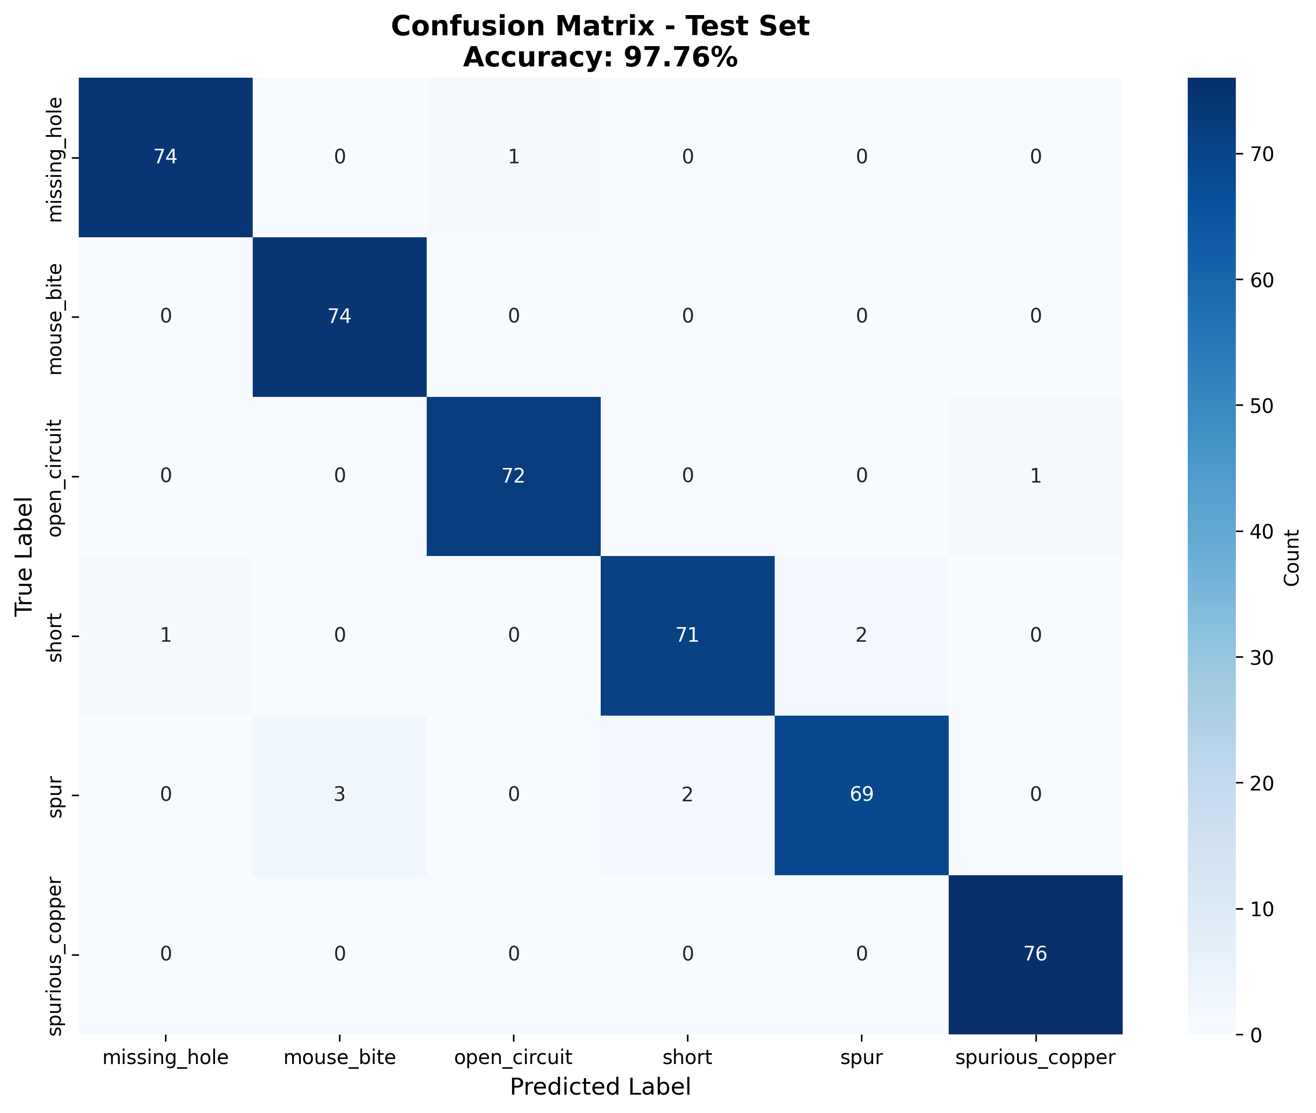
Confusion Matrix
Strong Diagonal Performance
Most predictions fall on diagonal
Minimal confusion between classes
Confidence Analysis
Mean Confidence:
Correct Predictions: 98.5%
Incorrect Predictions: 72.3%

Slide 10
Web Application
Features Implemented
Image Upload
Drag & drop interface
File browser support
Real-time preview
Prediction Engine
Single image classification
Confidence scoring
Top-3 predictions

Slide 11
Web Application Interface
Step 1: Upload Image
Drag & drop PCB defect image
Preview uploaded image
Step 2: Analyze
Click "Analyze Defect" button
Processing < 1 second
Step 3: View Results
Predicted defect class
Confidence percentage
Probability distribution chart
Step 4: Export
Download annotated images
Export prediction logs (CSV)

Slide 12
Application Features
Two Operating Modes
1. Classification Only
Direct defect classification
Single image input
Fast inference
2. Full Pipeline Mode
Template comparison
Image subtraction
Contour detection
Multiple ROI classification

Slide 13
Future Enhancements
Integration
Cloud-based solution
Model Improvements
Ensemble methods (multi-model voting)
Self-attention mechanisms
Semi-supervised learning
Application Features
Batch processing capability
Real-time video stream analysis
Mobile application

